Slide 1

Intro to Practical development
Making things with raspberry Pi and Python!

Slide 2


before we begin
Logistics and important info
Introductions
Name
What do you want to learn today?
What is the last book you read?
Notes:
LOGISTICS
INTRODUCTIONS

Slide 3
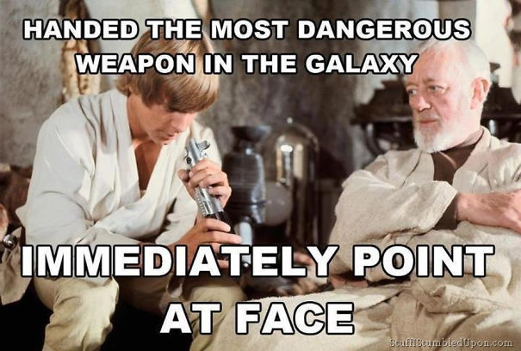
What will you get out of today’s session?
Just enough to be dangerous CURIOUS and do more!
Notes:
THIS IS DESIGNED TO GIVE YOU THE BASICS SO YOU CAN GO FURTHER ON YOUR OWN

Slide 4
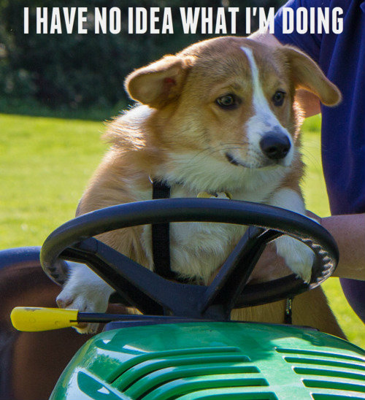

What *are* we doing?
Electrical Engineering 50
Basic Python 100
Fundamentals of IoT
Making! Hacking! Developing!
Notes:
In the next 3 hours I will give you:
A crash course in EE
A basic developer course in Python
How to be a tinkerer

Slide 5
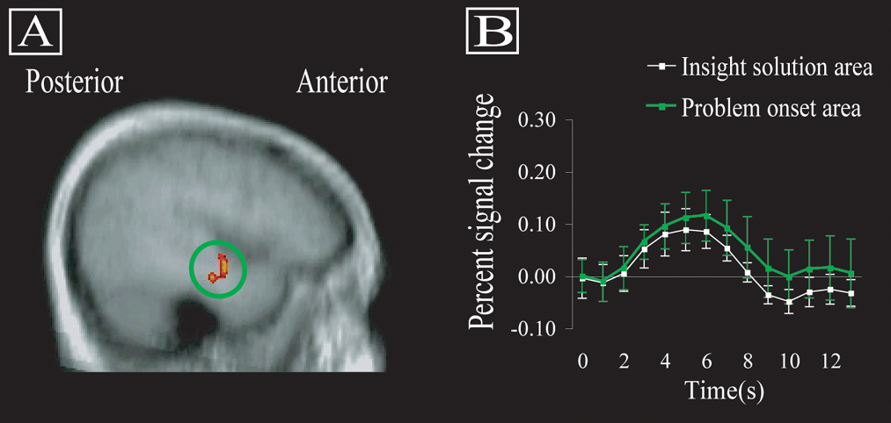
Practical Development
Why “practical” development?
Physical confirmation of logical creations
The “aha” moment
Notes:
WHY PRACTICAL DEVELOPMENT?
WHY THIS PROJECT?
WHERE DID THIS IDEA COME FROM?
Make sure to tell the story about your son being loud and wanting a way to influence his behavior

Slide 6
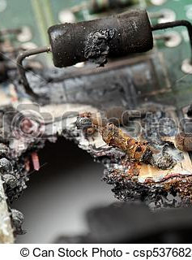
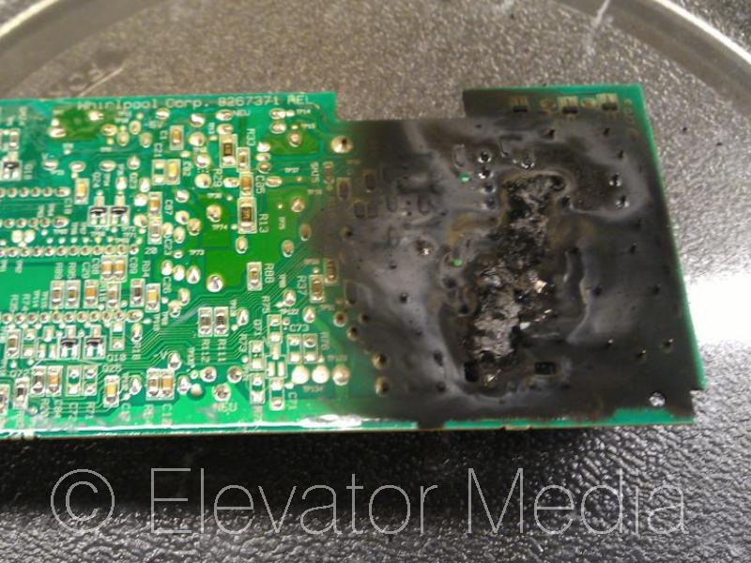
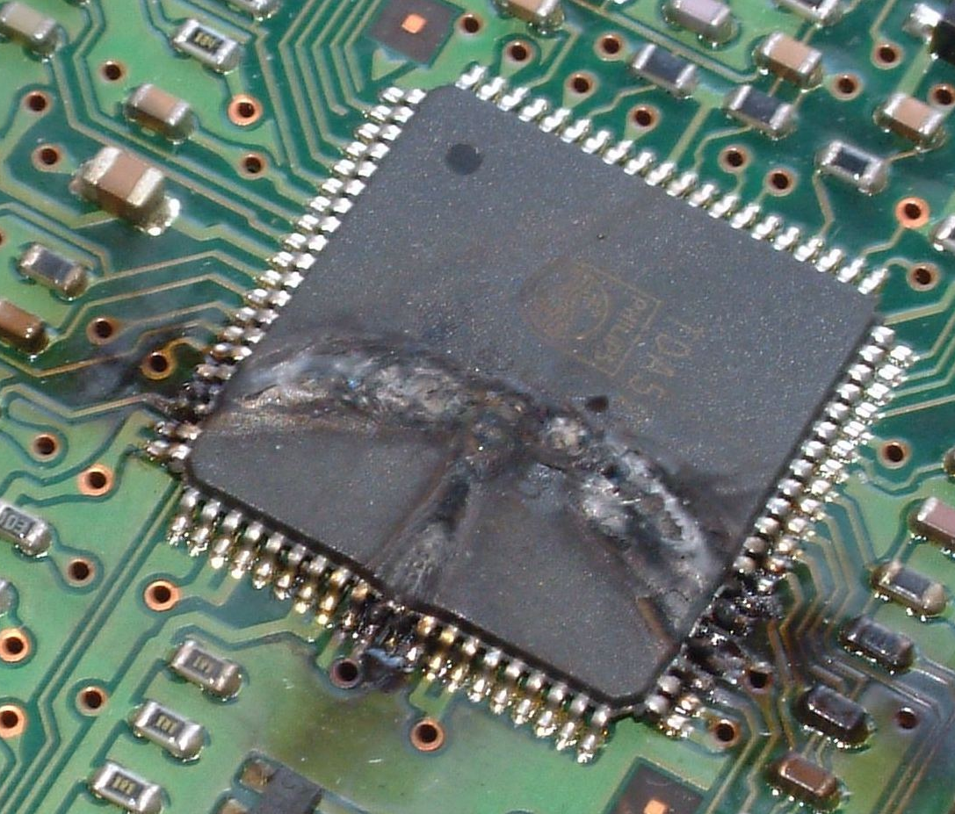
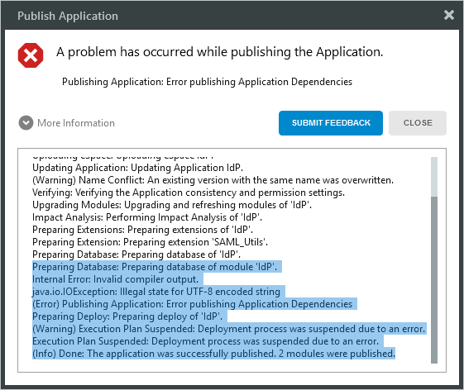
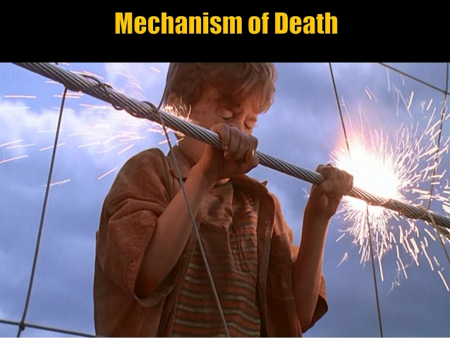
Why is hardware scary?
Software errors are “soft”
Hardware errors on the other hand….
ELECTRICITY KILLS PEOPLE!
Notes:
Getting over working with hardware

Slide 7
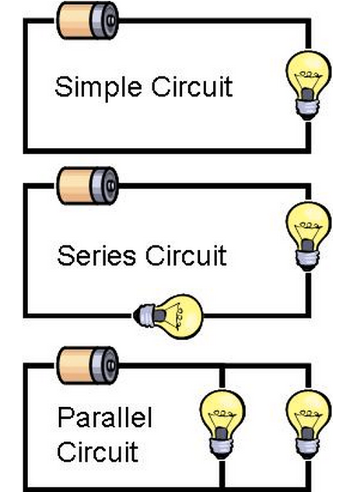
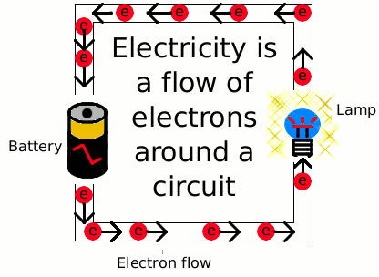
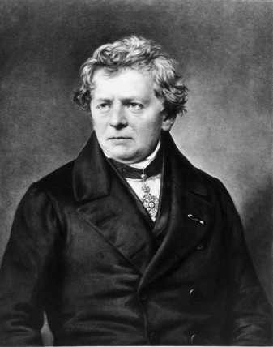
Electricity fundamentals
Electricity is flowing electrons
Flow is channeled through circuits, like water through plumbing
Flow is governed by Ohm’s law:
Voltage (Pressure)
Current (Amperes – same as Speed)
Resistance (Diameter of the pipes)
Notes:
Wiring is a lot like plumbing
Power out or - terminal is the “faucet”
Ground or the + terminal is the “drain”
Ohm did his work on resistance in the years 1825 and 1826, and published his results in 1827 as the book Die galvanische Kette, mathematisch bearbeitet ("The galvanic circuit investigated mathematically").[

Slide 8
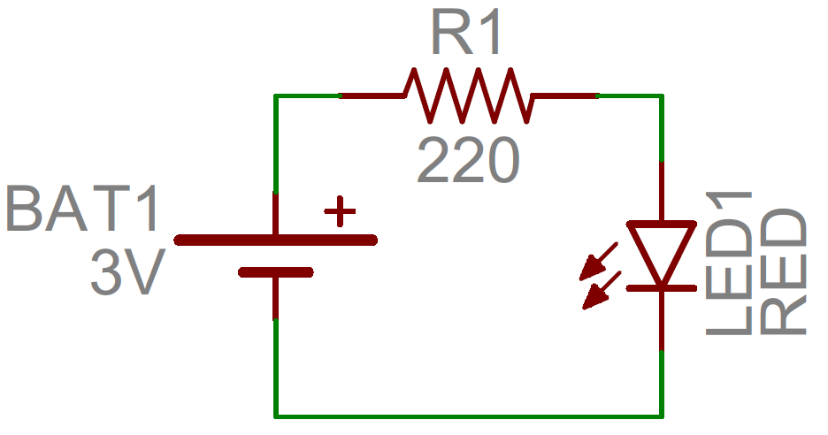
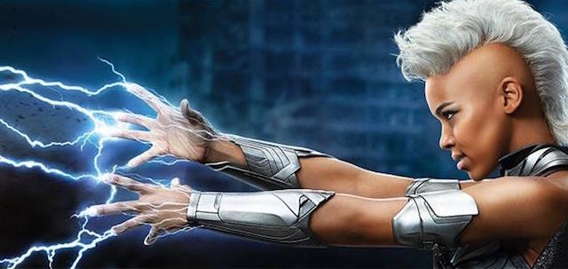
Control Over electricity
To flow, electricity needs a source and a ground
The Pi provides multiple sources and grounds
Note which one your project requires!
All amps are in milli-amps and 3 or 5 V
You are now one of the X-Men
*Inclusion in X-Men adventures not guaranteed
Notes:
Mention the 3v 5v issue with Jerry Bot

Slide 9
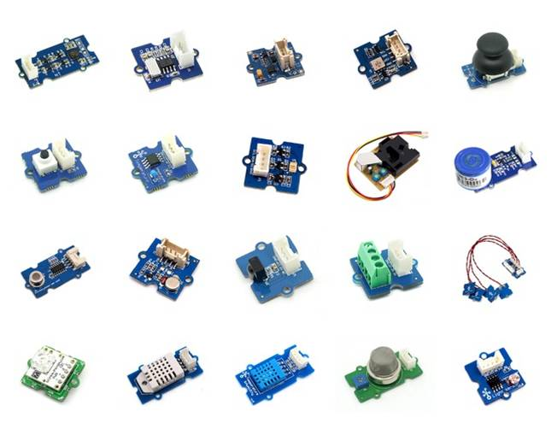
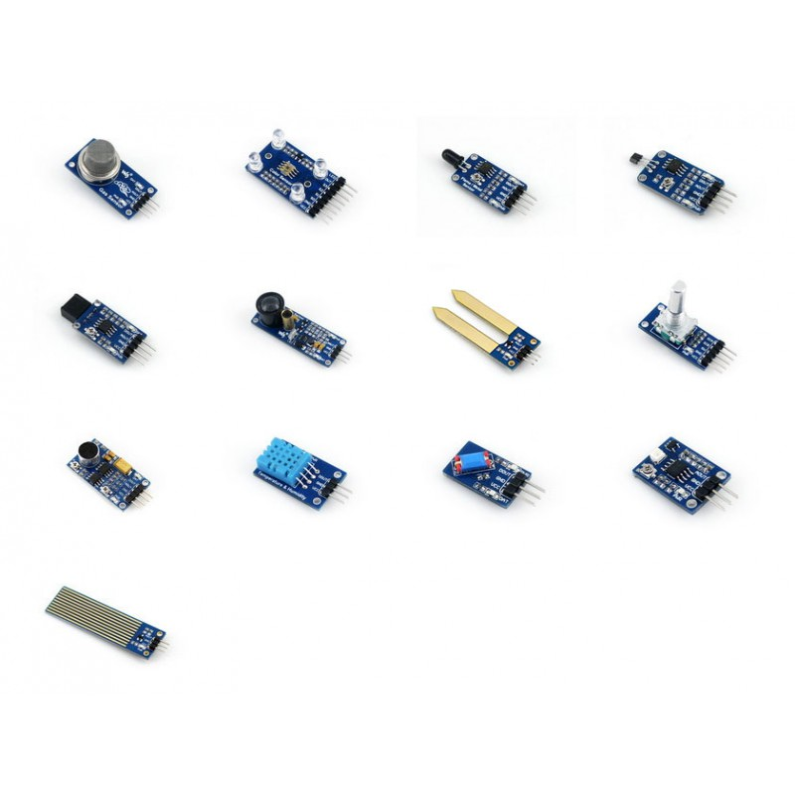
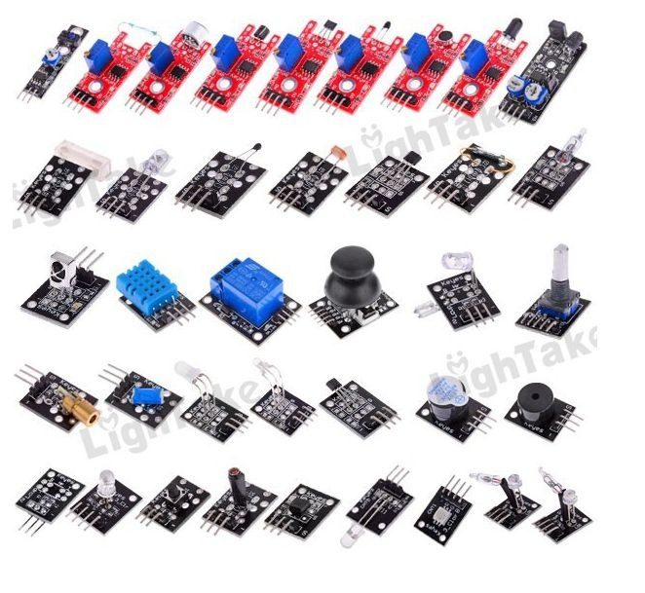
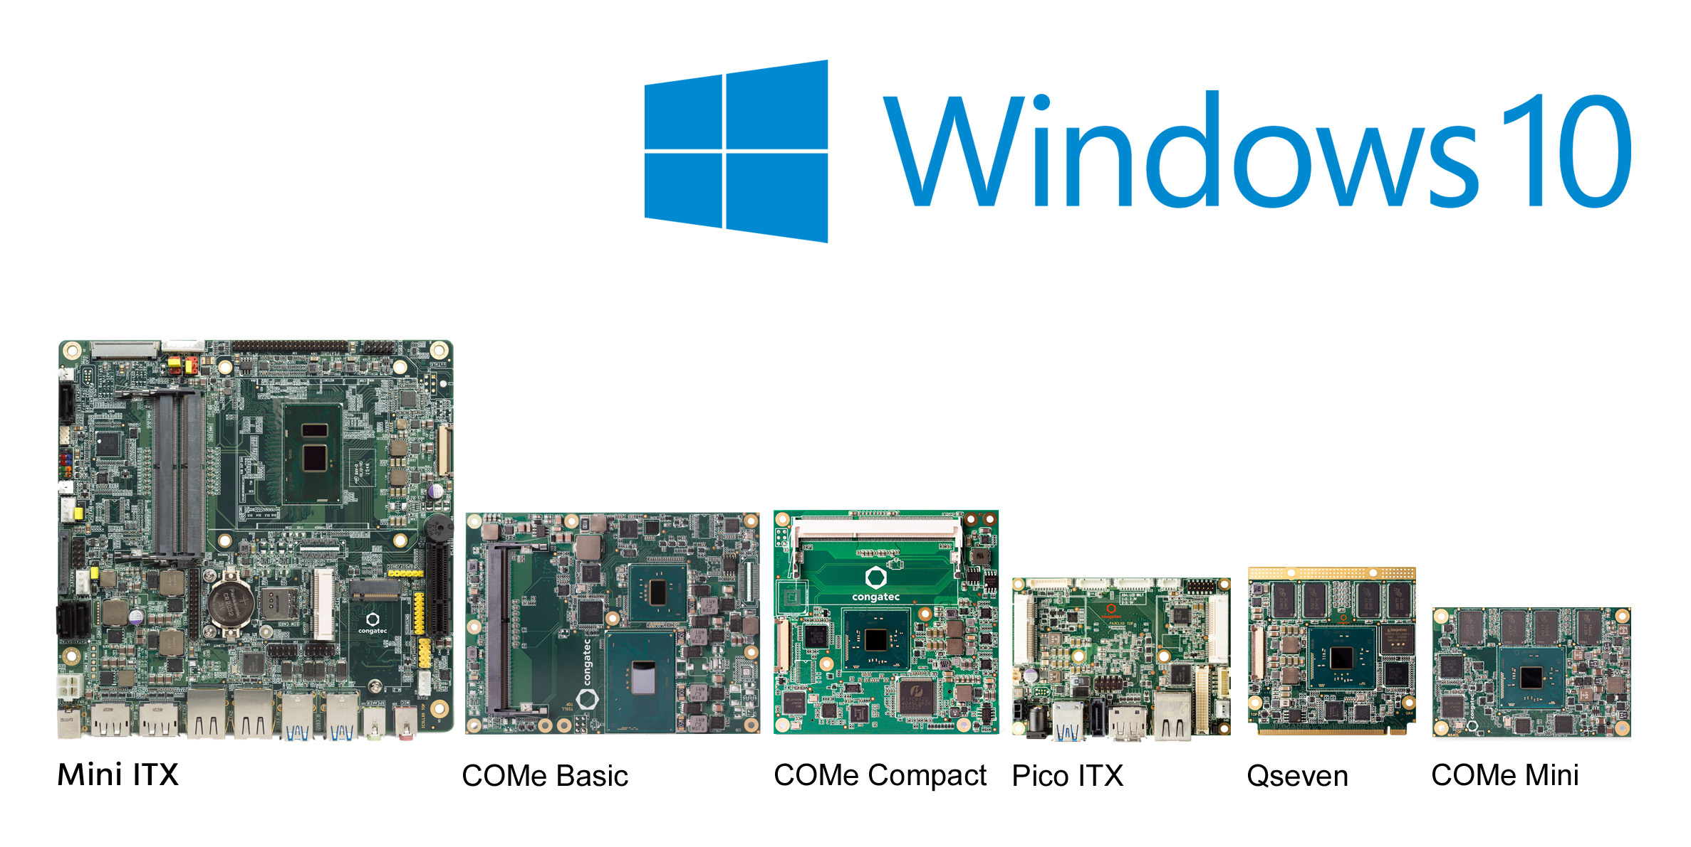
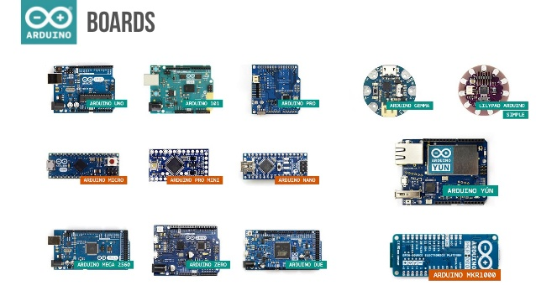
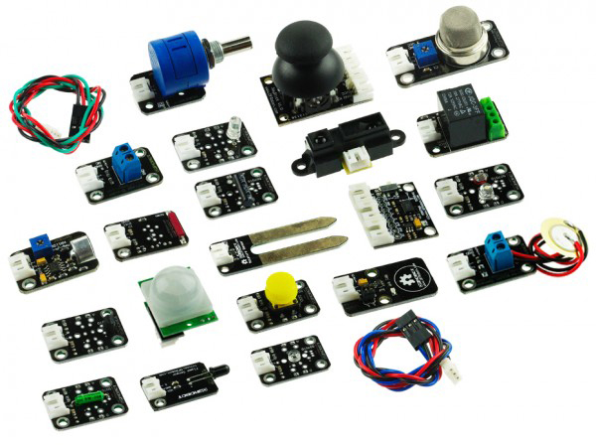
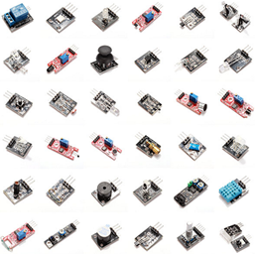
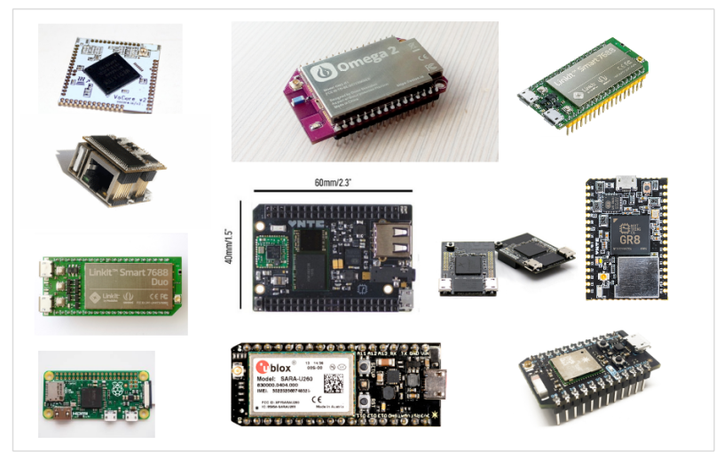
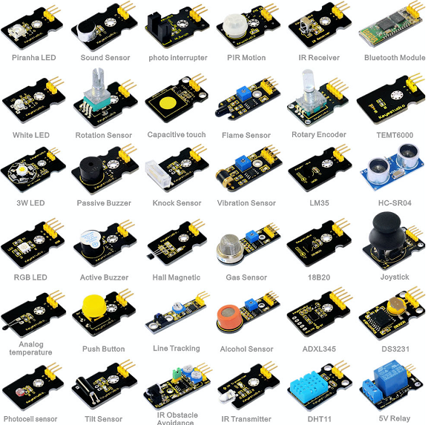
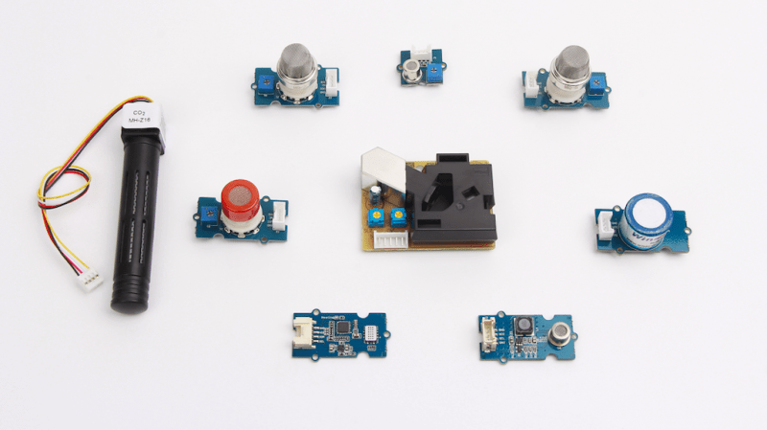
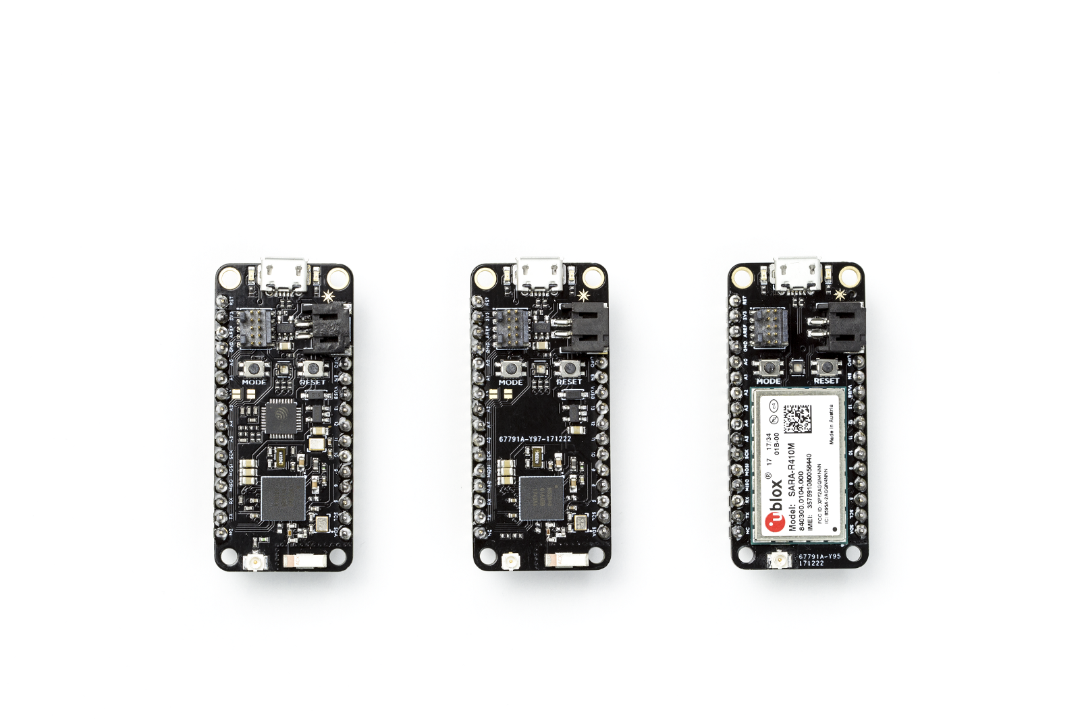
Hardware Overload
Notes:
Second reason hardware is kind of challenging? Where do you start?

Slide 10
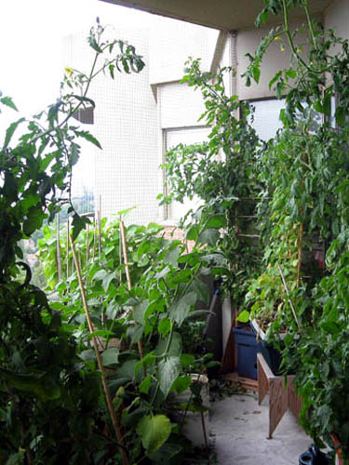
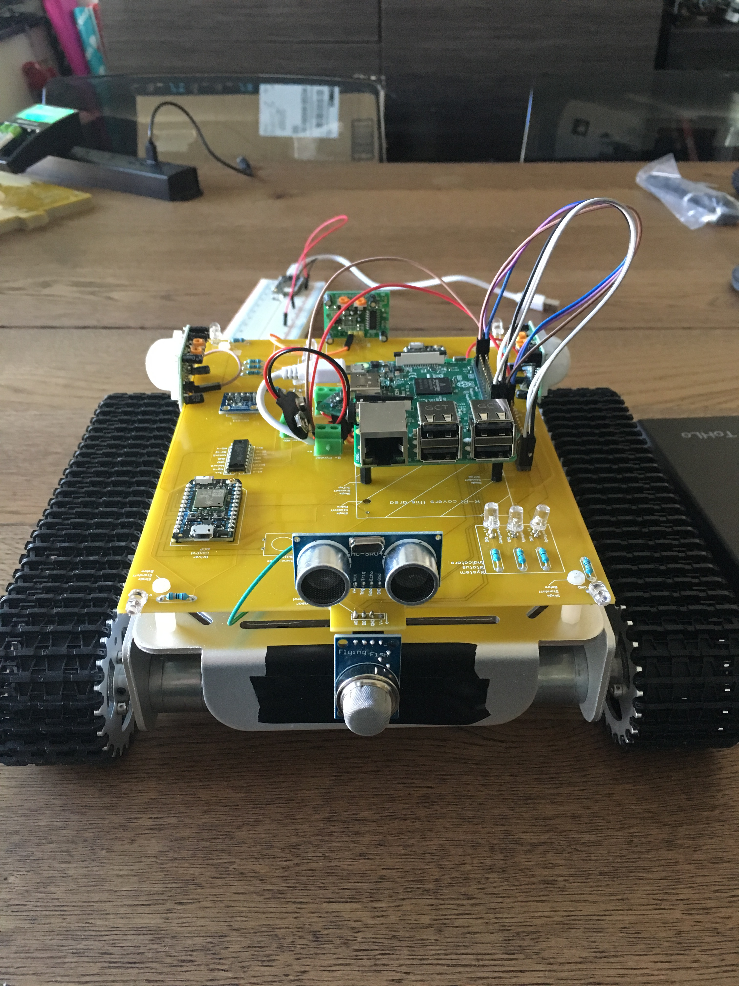

Pick a Project first!
Simplify your selection process
Helps you chose the right platform
Clarifies how to get to the end state

Slide 11
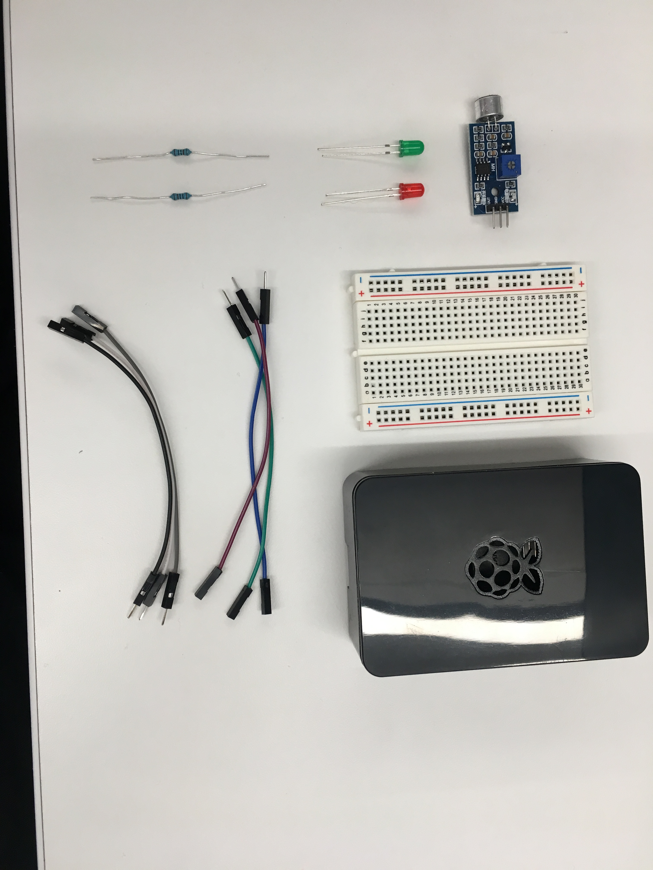
OUR Hardware – AKA What’s in this box?
Basic hardware required to build our project
Breadboard
Wires
Lights
Resistors
Sensor
Raspberry Pi 3

Slide 12
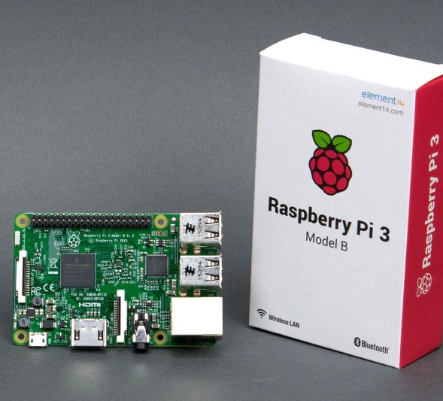
Raspberry Pi
Why Pi?
First to market
Small, light, and “good enough”
Why NOT Pi?
Speed
Overhead
Power
Notes:
Cheap, easy, “real computer” means it is more accessible
Not good for real-time situations and definitely not good at catching things with absolute timings

Slide 13
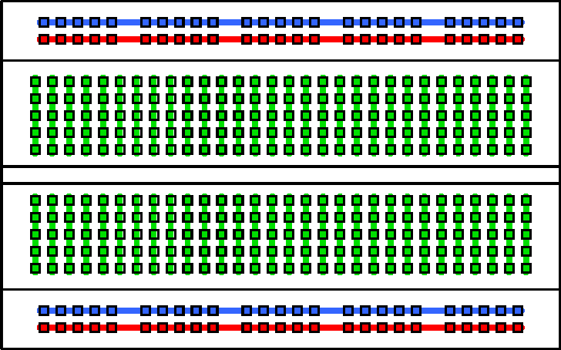
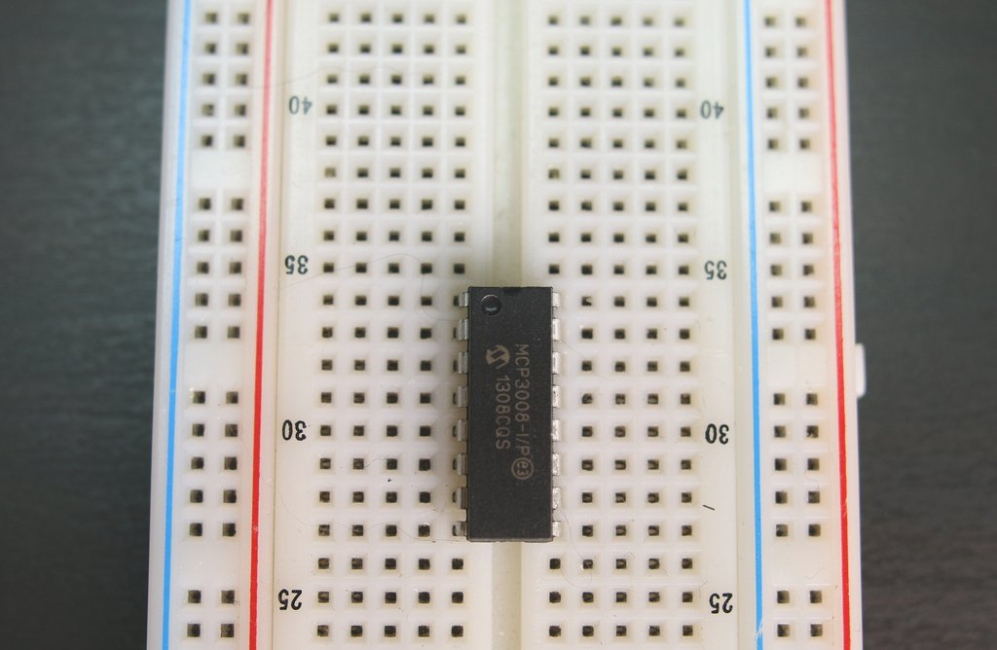
Breadboard basics
IC Chip
Terminal Strips
Columns (#’s)
IC Chip “Ravine”
Rows (Letters)

Slide 14
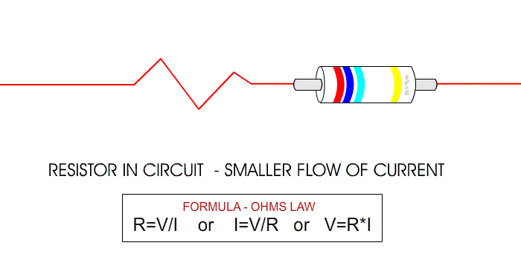
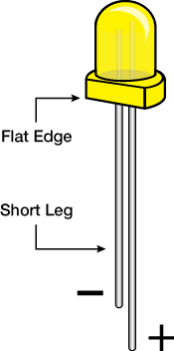
Resistors and LEDs
Notes:
Resistors reduce flow by introducing resistance to the electrical current
Graded in value of that resistance (OHMS)
Governed by Ohms law
LED lights make light through magic – small leg is the Ground side

Slide 15
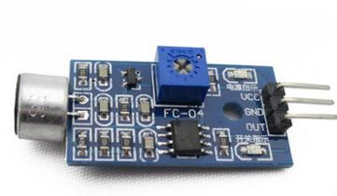
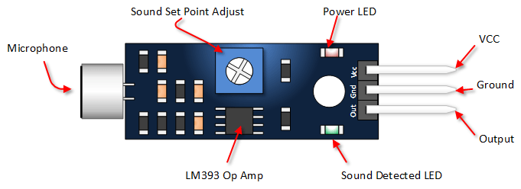
SENSOR Basics
Common Sensor pinout:
VCC = power IN
GND = power OUT (Ground)
Out(put) = signal out
Sometimes you get:
A0 = Analog output
D0 = Digital output

Slide 16
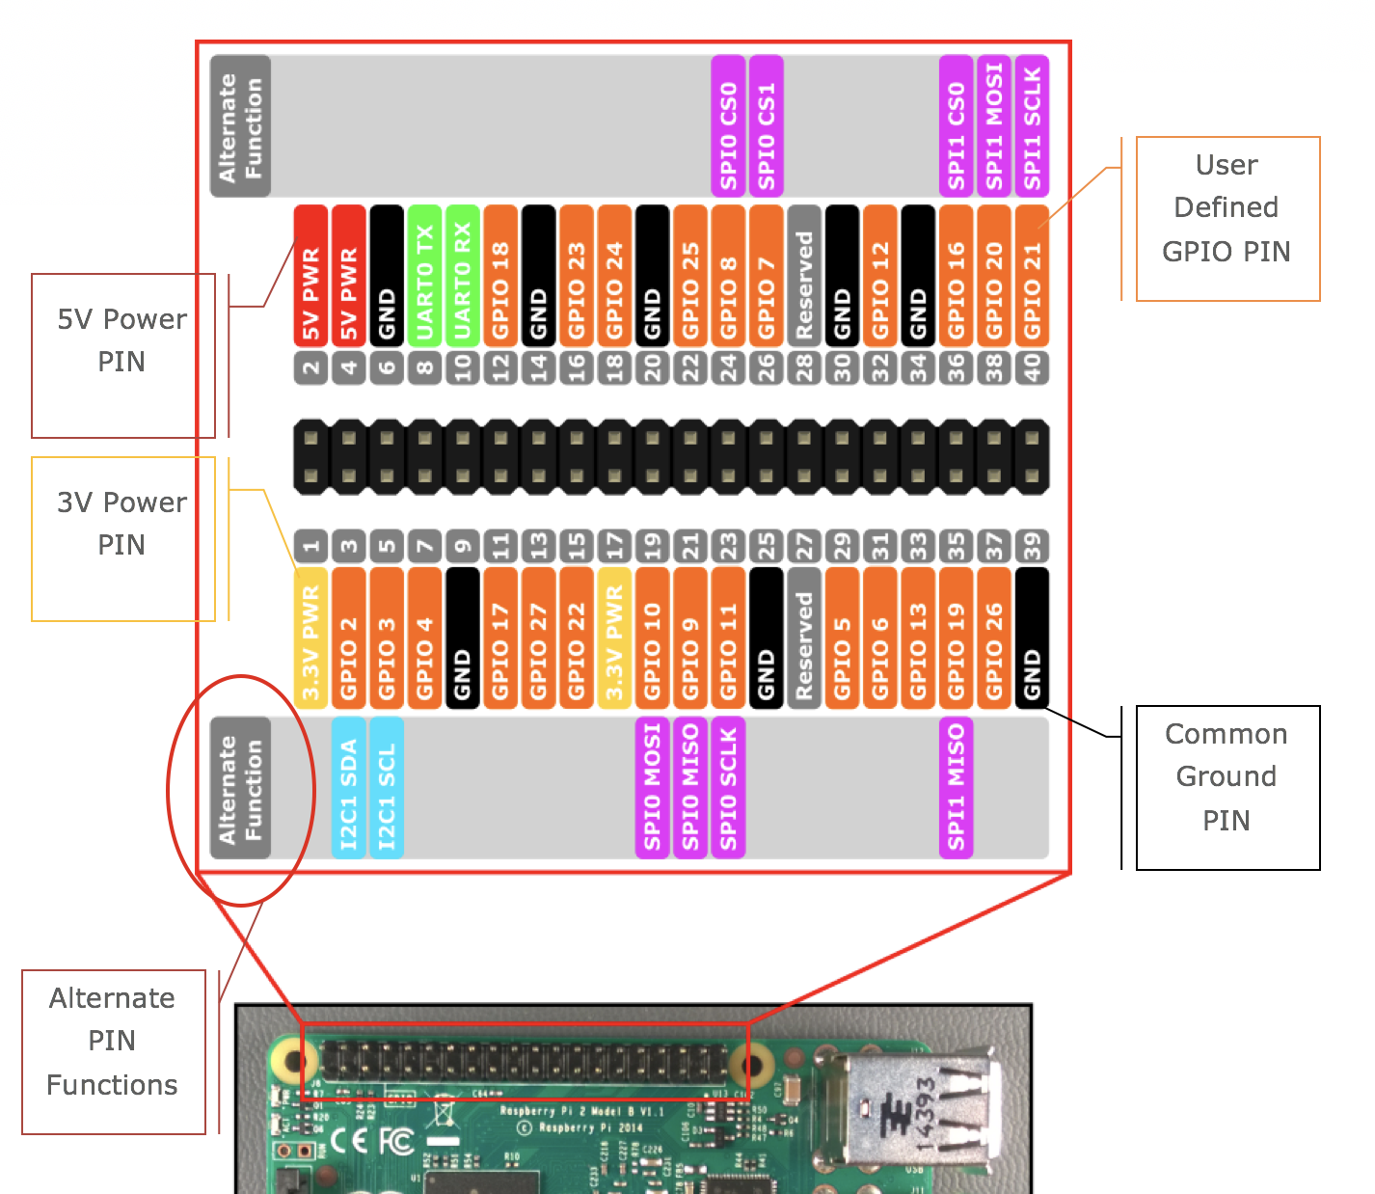
A pinout ‘splainer
Power
Ground
GPIO
Alternate Functions
Notes:
Page 7 in the companion
Refer back to the electricity slide – every one of these pins is effectively a battery “-” sign – some are on all the time and some you control. They can go in or out.

Slide 17
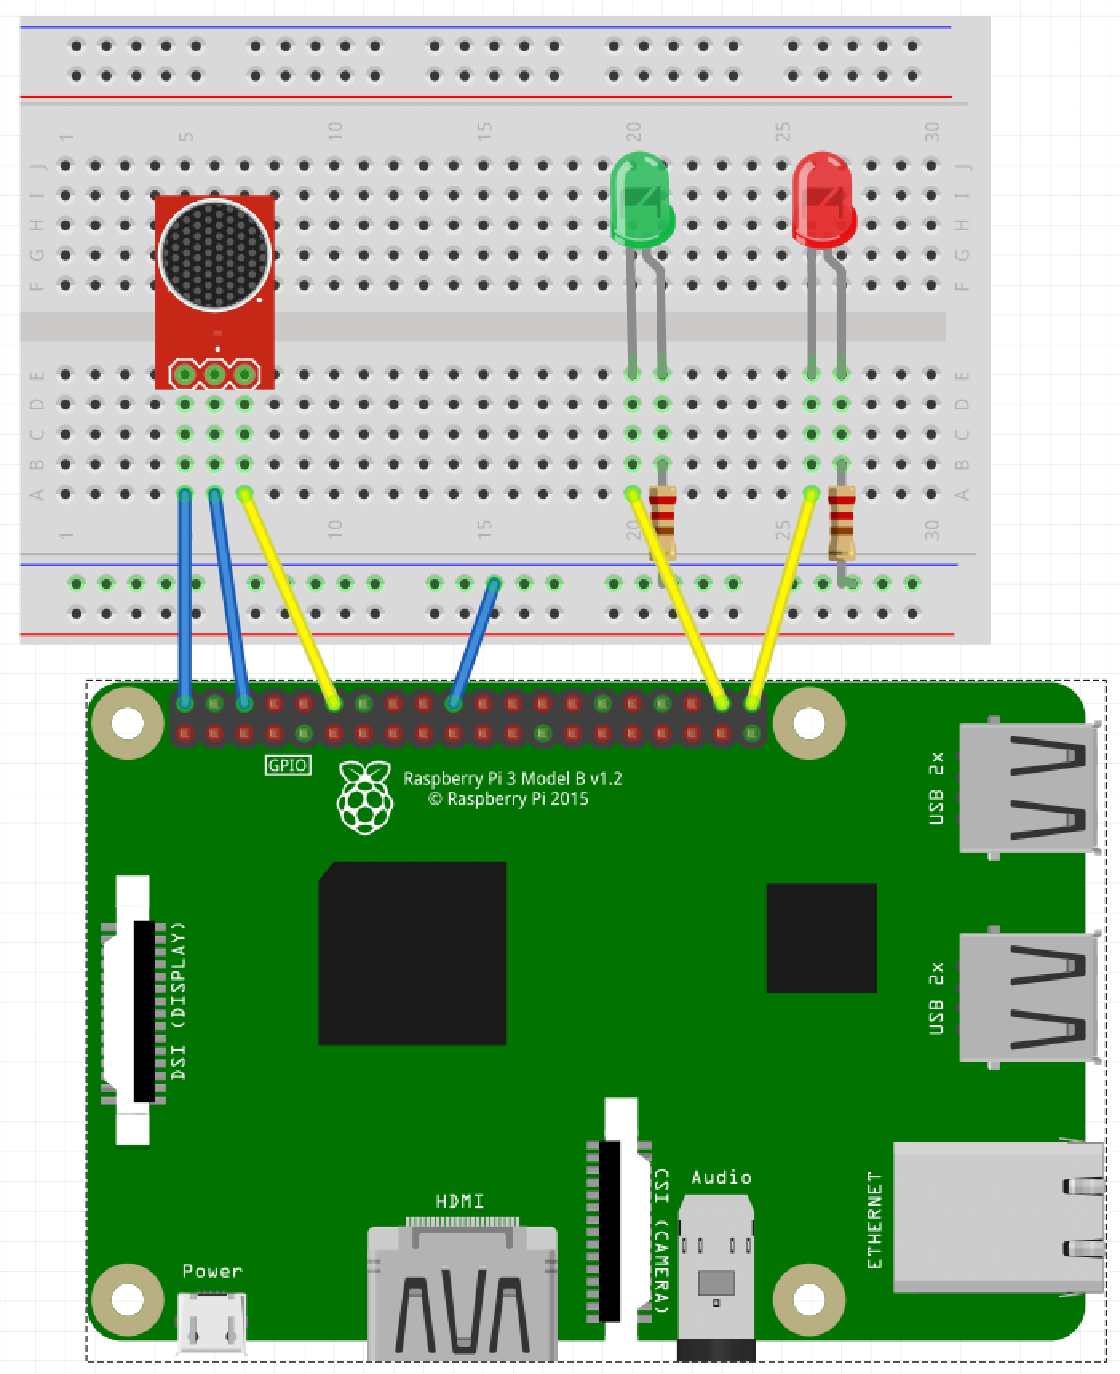
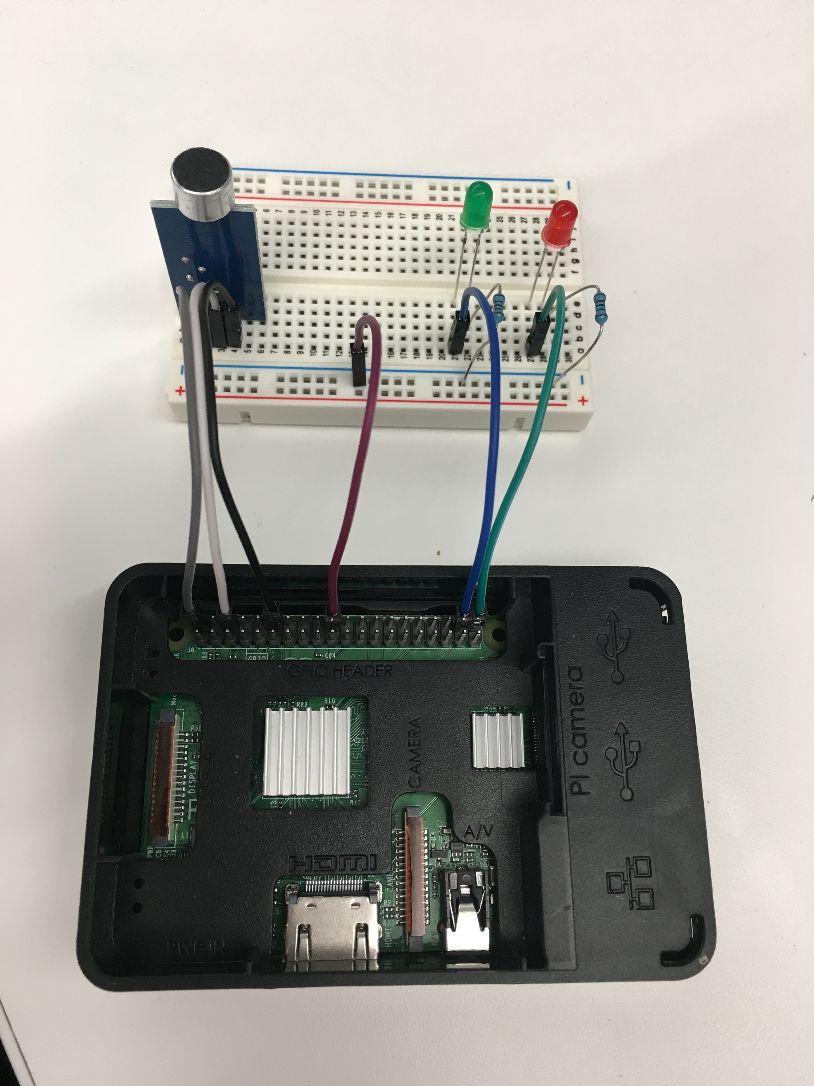
Slapping it all together
KISS – keep it simple, son!
Notes:
During the build, talk about things like:
Prototype vs commercial
Screwing around versus functional building
Long-term things you can do to get serious

Slide 18
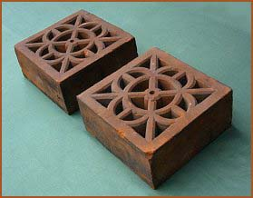
Now we have a Fancy Brick
It looks cool!
It matches the picture
It doesn’t do anything
Yet!

Slide 19

Take 15 minutes to RECOVER!

Slide 20
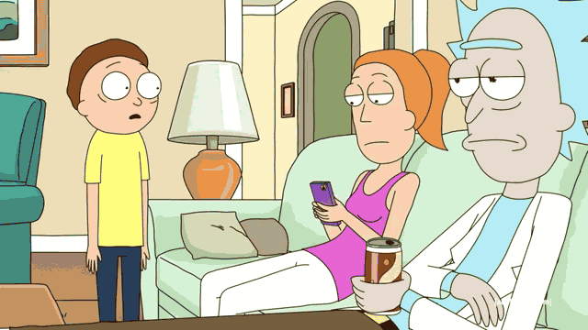
Take 15 more minutes to celebrate!

Slide 21
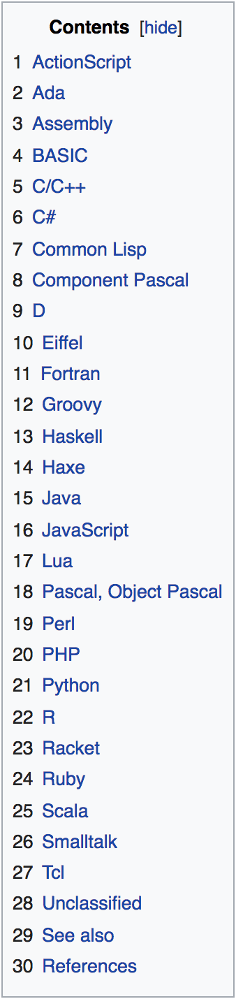

Code power!
How do we “build” software?
What are the resources you need?
Keeping track of code?

Slide 22
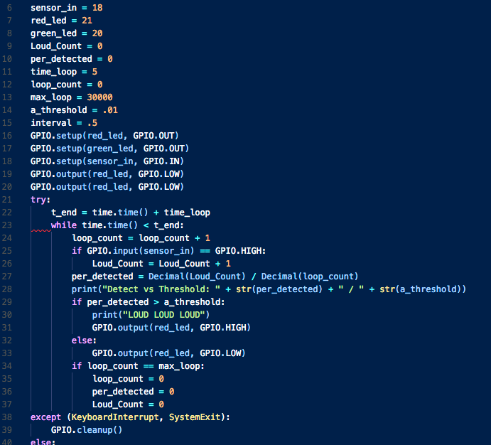
Software BASICS
Variables
Functions
Inputs
Outputs
Notes:
Languages and syntaxes and etc… all boil down to 4 things:

Slide 23

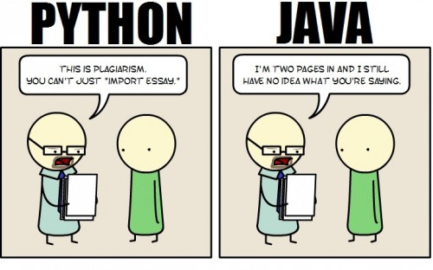

Why Python?

Slide 24
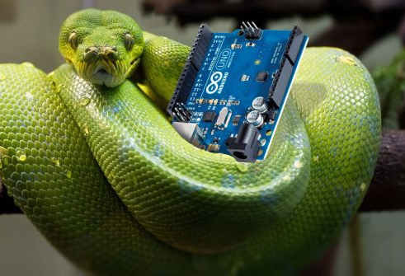

AS regards Python
Compact
Terse
Dynamically Typed
Control Characters
Structure (Indentation)
Notes:
Compact – do a LOT with a few lines of code
Terse – simple syntax and structure so less to type (good for lazy devs like me!)
Dynamically Typed – this means stuff changes during the code execution – this can be bad when you are learning, but will be so much easier later
Control Characters – there are very few unlike Java for example
Structure – STRICT on indenting and spaces/tabs and the use of them!!

Slide 25
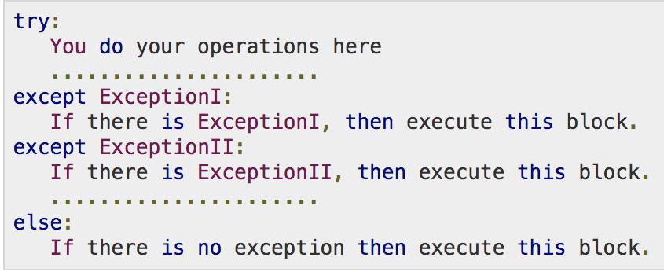
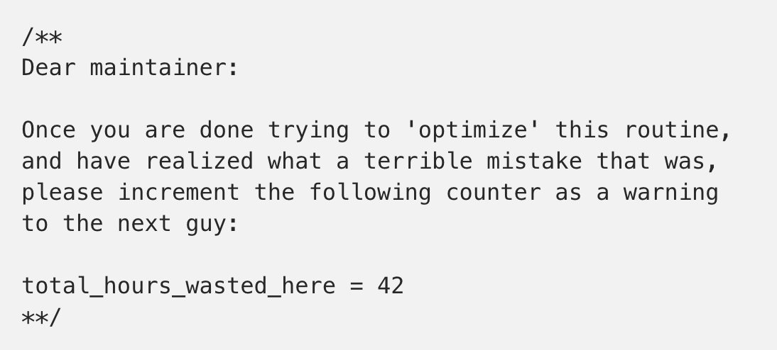
Other Py things
try and except blocks
Suites (if statements are suites)
File extension is .py
COMMENTS! # for starting a comment

Slide 26
Getting started with writing code
A development tool
A place to save code
Access to other libraries and info

Slide 27
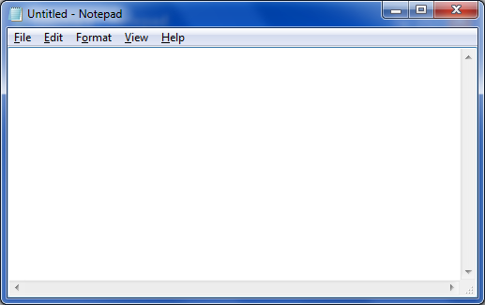
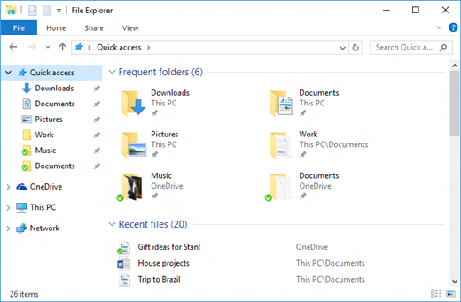









A TOOL
A PLACE TO PUT IT
RESOURCES

Slide 28
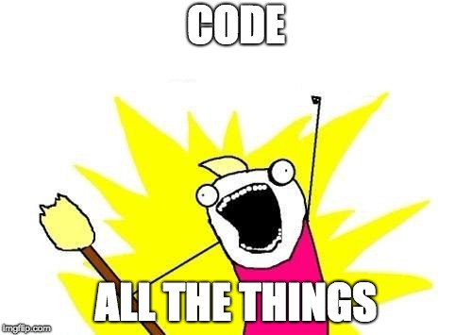
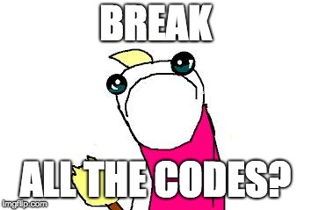
IT’s Coding time!

Slide 29
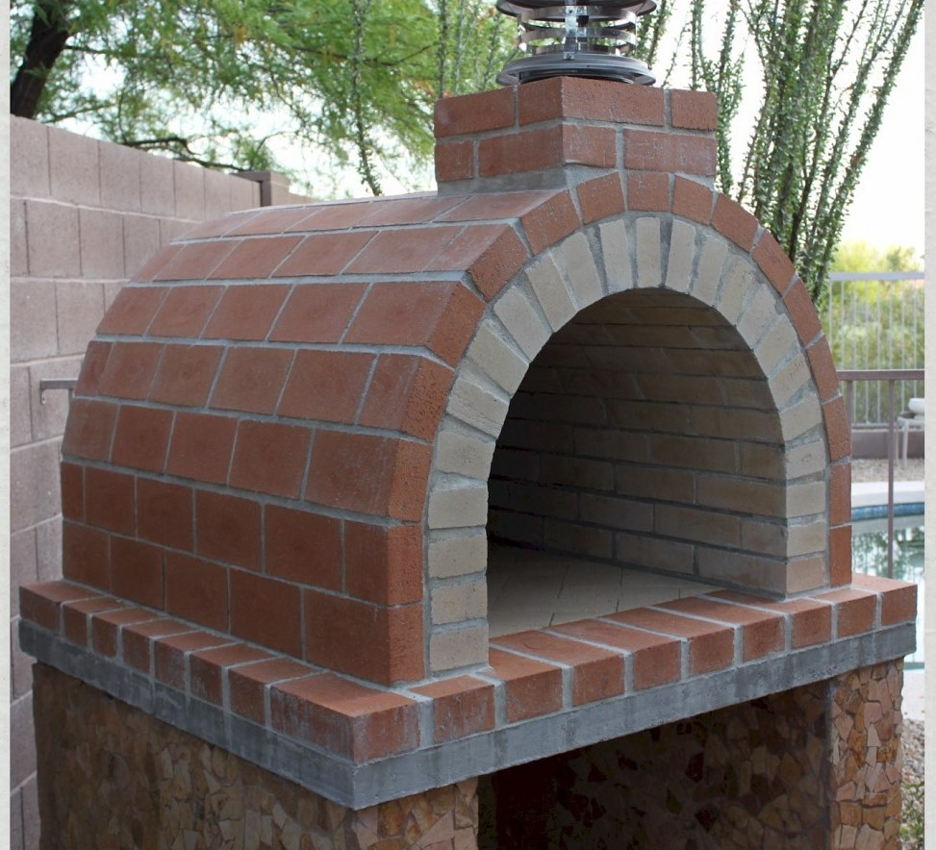
You have now made a brick oven!
It serves a functional purpose
It doesn’t just sit there
It works like you coded it to!

Slide 30


What’s next?
You have just taken the ”gateway drug” of making
Now your little oven will start to trigger new ideas and things you want to add
Soon you will have a fancy brick oven!
And your amazon order history will look like this:

Slide 31

Congratulations!
You’re officially an IoT Developer! Don’t forget to come get your Sticker!!

Slide 32

While we do Q and a
Disassemble your circuits
Put the parts in the baggie
Put everything back in the box

Slide 33
Some resources for you And a Favor for me
Official Resources:
Raspberypi.org
Python.org
Other Resources:
Youtube! Instructables! Amazon!
Github.com/ChrisHarrold
@charrold303 @codecoffeeyvr
A Favor:
http://bit.ly/charrold

